Slide 1
My SQL
Made by: Eng. Doaa m.Abd elfatah

Slide 2
Displaying Data from Multiple Tables
join

Slide 3

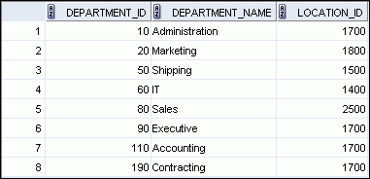

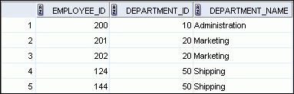

Obtaining Data from Multiple Tables
EMPLOYEES
DEPARTMENTS
…
…
Notes:
Obtaining Data from Multiple Tables
Sometimes you need to use data from more than one table. In the example in the slide, the report displays data from two separate tables:
Employee IDs exist in the EMPLOYEES table.
Department IDs exist in both the EMPLOYEES and DEPARTMENTS tables.
Department names exist in the DEPARTMENTS table.
To produce the report, you need to link the EMPLOYEES and DEPARTMENTS tables, and access data from both of them.

Slide 4
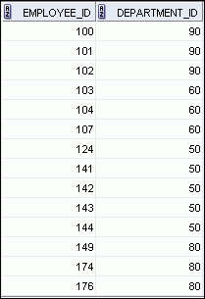
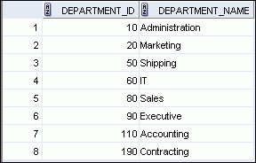
Joining Column Names
EMPLOYEES
DEPARTMENTS
Primary key
…
Foreign key
Notes:
Joining Column Names
To determine an employee’s department name, you compare the value in the DEPARTMENT_ID column in the EMPLOYEES table with the DEPARTMENT_ID values in the DEPARTMENTS table. The relationship between the EMPLOYEES and DEPARTMENTS tables is an equijoin; that is, values in the DEPARTMENT_ID column in both the tables must be equal. Frequently, this type of join involves primary and foreign key complements.
Note: Equijoins are also called simple joins or inner joins.

Slide 5
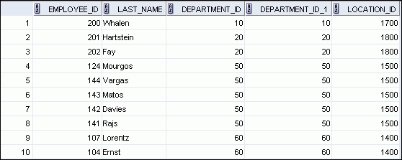
Retrieving Records with the ON Clause
SELECT e.employee_id, e.last_name, e.department_id,
d.department_id, d.location_id
FROM employees e JOIN departments d
ON (e.department_id = d.department_id);
…
Notes:
Retrieving Records with the ON Clause
In this example, the DEPARTMENT_ID columns in the EMPLOYEES and DEPARTMENTS table are joined using the ON clause. Wherever a department ID in the EMPLOYEES table equals a department ID in the DEPARTMENTS table, the row is returned. The table alias is necessary to qualify the matching column_names.
You can also use the ON clause to join columns that have different names. The parenthesis around the joined columns as in the slide example, (e.department_id = d.department_id) is optional. So, even ON e.department_id = d.department_id will work.
Note: SQL Developer suffixes a ‘_1’ to differentiate between the two department_ids.

Slide 6
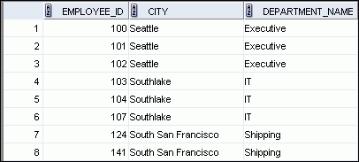
Creating Three-Way Joins with the ON Clause
SELECT employee_id, city, department_name
FROM employees e
JOIN departments d
ON d.department_id = e.department_id
JOIN locations l
ON d.location_id = l.location_id;
…
Notes:
Creating Three-Way Joins with the ON Clause
A three-way join is a join of three tables. In SQL:1999–compliant syntax, joins are performed from left to right. So, the first join to be performed is EMPLOYEES JOIN DEPARTMENTS. The first join condition can reference columns in EMPLOYEES and DEPARTMENTS but cannot reference columns in LOCATIONS. The second join condition can reference columns from all three tables.
Note: The code example in the slide can also be accomplished with the USING clause:
SELECT e.employee_id, l.city, d.department_name
FROM employees e
JOIN departments d
USING (department_id)
JOIN locations l
USING (location_id)

Slide 7
Applying Additional Conditions to a Join
Use the AND clause or the WHERE clause to apply additional conditions:
SELECT e.employee_id, e.last_name, e.department_id,
d.department_id, d.location_id
FROM employees e JOIN departments d
ON (e.department_id = d.department_id)
AND e.manager_id = 149 ;
Or
SELECT e.employee_id, e.last_name, e.department_id,
d.department_id, d.location_id
FROM employees e JOIN departments d
ON (e.department_id = d.department_id)
WHERE e.manager_id = 149 ;
Notes:
Applying Additional Conditions to a Join
You can apply additional conditions to the join.
The example shown performs a join on the EMPLOYEES and DEPARTMENTS tables and, in addition, displays only employees who have a manager ID of 149. To add additional conditions to the ON clause, you can add AND clauses. Alternatively, you can use a WHERE clause to apply additional conditions.

Slide 8
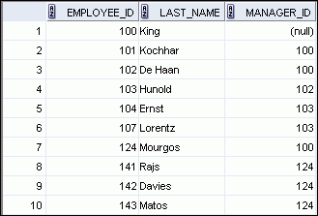
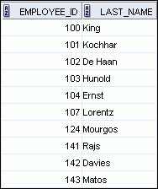
Joining a Table to Itself
EMPLOYEES (WORKER)
EMPLOYEES (MANAGER)
…
…
MANAGER_ID in the WORKER table is equal to EMPLOYEE_ID in the MANAGER table.
Notes:
Joining a Table to Itself
Sometimes you need to join a table to itself. To find the name of each employee’s manager, you need to join the EMPLOYEES table to itself, or perform a self-join. For example, to find the name of Lorentz’s manager, you need to:
Find Lorentz in the EMPLOYEES table by looking at the LAST_NAME column
Find the manager number for Lorentz by looking at the MANAGER_ID column. Lorentz’s manager number is 103.
Find the name of the manager with EMPLOYEE_ID 103 by looking at the LAST_NAME column. Hunold’s employee number is 103, so Hunold is Lorentz’s manager.
In this process, you look in the table twice. The first time you look in the table to find Lorentz in the LAST_NAME column and the MANAGER_ID value of 103. The second time you look in the EMPLOYEE_ID column to find 103 and the LAST_NAME column to find Hunold.

Slide 9
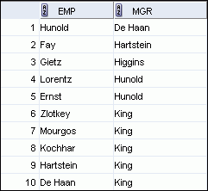
Self-Joins Using the ON Clause
SELECT worker.last_name emp, manager.last_name mgr
FROM employees worker JOIN employees manager
ON (worker.manager_id = manager.employee_id);
…
Notes:
Self-Joins Using the ON Clause
The ON clause can also be used to join columns that have different names, within the same table or in a different table.
The example shown is a self-join of the EMPLOYEES table, based on the EMPLOYEE_ID and MANAGER_ID columns.
Note: The parenthesis around the joined columns as in the slide example, (e.manager_id = m.employee_id) is optional. So, even ON e.manager_id = m.employee_id will work.

Slide 10
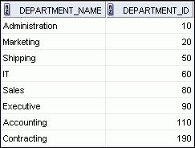
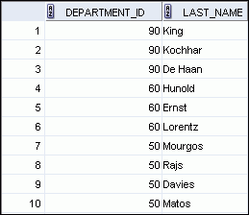

Returning Records with No Direct Match with Outer Joins
DEPARTMENTS
EMPLOYEES
…
There are no employees in department 190.
Notes:
Returning Records with No Direct Match with Outer Joins
If a row does not satisfy a join condition, the row does not appear in the query result. For example, in the equijoin condition of EMPLOYEES and DEPARTMENTS tables, department ID 190 does not appear because there are no employees with that department ID recorded in the EMPLOYEES table. Therefore, instead of seeing 20 employees in the result set, you see 19 records.
To return the department record that does not have any employees, you can use an outer join.

Slide 11
INNER Versus OUTER Joins
the join of two tables returning only matched rows is called an inner join.
A join between two tables that returns the results of the inner join as well as the unmatched rows from the left (or right) table is called a left (or right) outer join.
Notes:
INNER Versus OUTER Joins
Joining tables with the NATURAL JOIN, USING, or ON clauses results in an inner join. Any unmatched rows are not displayed in the output. To return the unmatched rows, you can use an outer join. An outer join returns all rows that satisfy the join condition and also returns some or all of those rows from one table for which no rows from the other table satisfy the join condition.
There are three types of outer joins:
LEFT OUTER
RIGHT OUTER
FULL OUTER

Slide 12
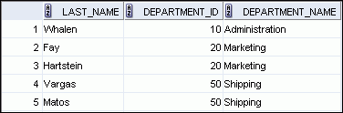

LEFT OUTER JOIN
SELECT e.last_name, e.department_id, d.department_name
FROM employees e LEFT OUTER JOIN departments d
ON (e.department_id = d.department_id) ;
…
Notes:
LEFT OUTER JOIN
This query retrieves all rows in the EMPLOYEES table, which is the left table, even if there is no match in the DEPARTMENTS table.

Slide 13
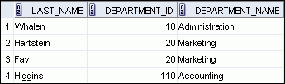

RIGHT OUTER JOIN
SELECT e.last_name, e.department_id, d.department_name
FROM employees e RIGHT OUTER JOIN departments d
ON (e.department_id = d.department_id) ;
…
Notes:
RIGHT OUTER JOIN
This query retrieves all rows in the DEPARTMENTS table, which is the right table, even if there is no match in the EMPLOYEES table.

Slide 14
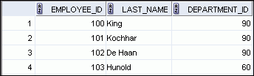

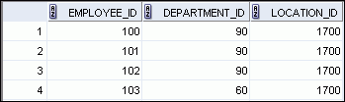

Generating a Cartesian Product
EMPLOYEES (20 rows)
DEPARTMENTS (8 rows)
…
Cartesian product: 20 x 8 = 160 rows
…
Notes:
Generating a Cartesian Product
A Cartesian product is generated if a join condition is omitted. The example in the slide displays the employee last name and the department name from the EMPLOYEES and DEPARTMENTS tables. Because no join condition was specified, all rows (20 rows) from the EMPLOYEES table are joined with all rows (8 rows) in the DEPARTMENTS table, thereby generating 160 rows in the output.

Slide 15
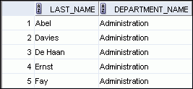

Creating Cross Joins
The CROSS JOIN clause produces the cross-product of two tables.
This is also called a Cartesian product between the two tables.
SELECT last_name, department_name
FROM employees
CROSS JOIN departments ;
…
Notes:
Creating Cross Joins
The example in the slide produces a Cartesian product of the EMPLOYEES and DEPARTMENTS tables.

Slide 16
Using Subqueries to Solve Queries

Slide 17



Using a Subquery to Solve a Problem
Who has a salary greater than Abel’s?
Main query:
Which employees have salaries greater than Abel’s salary?
Subquery:
What is Abel’s salary?
Notes:
Using a Subquery to Solve a Problem
Suppose you want to write a query to find out who earns a salary greater than Abel’s salary.
To solve this problem, you need two queries: one to find how much Abel earns, and a second query to find who earns more than that amount.
You can solve this problem by combining the two queries, placing one query inside the other query.
The inner query (or subquery) returns a value that is used by the outer query (or main query). Using a subquery is equivalent to performing two sequential queries and using the result of the first query as the search value in the second query.

Slide 18
Subquery Syntax
SELECT select_list
FROM table
WHERE expr operator
(SELECT select_list
FROM table);
The subquery (inner query) executes before the main query (outer query).
The result of the subquery is used by the main query.
Notes:
Subquery Syntax
A subquery is a SELECT statement that is embedded in the clause of another SELECT statement. You can build powerful statements out of simple ones by using subqueries. They can be very useful when you need to select rows from a table with a condition that depends on the data in the table itself.
You can place the subquery in a number of SQL clauses, including the following:
WHERE clause
HAVING clause
FROM clause
In the syntax:
operator includes a comparison condition such as >, =, or IN
Note: Comparison conditions fall into two classes: single-row operators (>, =, >=, <, <>, <=) and multiple-row operators (IN, ANY, ALL).
The subquery is often referred to as a nested SELECT, sub-SELECT, or inner SELECT statement. The subquery generally executes first, and its output is used to complete the query condition for the main (or outer) query.

Slide 19
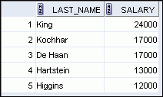
Using a Subquery
SELECT last_name, salary
FROM employees
WHERE salary >
(SELECT salary
FROM employees
WHERE last_name = 'Abel');
11000
Notes:
Using a Subquery
In the slide, the inner query determines the salary of employee Abel. The outer query takes the result of the inner query and uses this result to display all the employees who earn more than employee Abel.

Slide 20
Correlated Subqueries
A correlated subquery is a subquery that contains a reference to a table that also appears in the outer query. For example:
SELECT * FROM t1
WHERE column1 = ANY (SELECT column1 FROM t2
WHERE t2.column2 = t1.column2);

Slide 21
Using the Set Operators

Slide 22
Set Operators
A
B
A
B
UNION/UNION ALL
Notes:
Set Operators
Set operators combine the results of two or more component queries into one result. Queries containing set operators are called compound queries.
All set operators have equal precedence. If a SQL statement contains multiple set operators, the Oracle server evaluates them from left (top) to right (bottom)—if no parentheses explicitly specify another order. You should use parentheses to specify the order of evaluation explicitly in queries that use the INTERSECT operator with other set operators.

Slide 23
UNION Operator
A
B
The UNION operator returns rows from both queries after eliminating duplications.
Notes:
UNION Operator
The UNION operator returns all rows that are selected by either query. Use the UNION operator to return all rows from multiple tables and eliminate any duplicate rows.
Guidelines
The number of columns being selected must be the same.
The data types of the columns being selected must be in the same data type group (such as numeric or character).
The names of the columns need not be identical.
UNION operates over all of the columns being selected.
NULL values are not ignored during duplicate checking.
By default, the output is sorted in ascending order of the columns of the SELECT clause.

Slide 24


Using the UNION Operator
Display the current and previous job details of all employees. Display each employee only once.
SELECT employee_id, job_id
FROM employees
UNION
SELECT employee_id, job_id
FROM job_history;
…
…
Notes:
Using the UNION Operator
The UNION operator eliminates any duplicate records. If records that occur in both the EMPLOYEES and the JOB_HISTORY tables are identical, the records are displayed only once. Observe in the output shown in the slide that the record for the employee with the EMPLOYEE_ID 200 appears twice because the JOB_ID is different in each row.
Consider the following example:
SELECT employee_id, job_id, department_id
FROM employees
UNION
SELECT employee_id, job_id, department_id
FROM job_history;
…
…

Slide 25
UNION ALL Operator
A
B
The UNION ALL operator returns rows from both queries, including all duplications.
Notes:
UNION ALL Operator
Use the UNION ALL operator to return all rows from multiple queries.
Guidelines
The guidelines for UNION and UNION ALL are the same, with the following two exceptions that pertain to UNION ALL: Unlike UNION, duplicate rows are not eliminated and the output is not sorted by default.

Slide 26

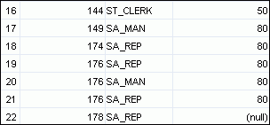
Using the UNION ALL Operator
Display the current and previous departments of all employees.
SELECT employee_id, job_id, department_id
FROM employees
UNION ALL
SELECT employee_id, job_id, department_id
FROM job_history
ORDER BY employee_id;
…
…
Notes:
Using the UNION ALL Operator
In the example, 30 rows are selected. The combination of the two tables totals to 30 rows. The UNION ALL operator does not eliminate duplicate rows. UNION returns all distinct rows selected by either query. UNION ALL returns all rows selected by either query, including all duplicates. Consider the query in the slide, now written with the UNION clause:
SELECT employee_id, job_id,department_id FROM employees UNION SELECT employee_id, job_id,department_id FROM job_history ORDER BY employee_id;
The preceding query returns 29 rows. This is because it eliminates the following row (because it is a duplicate):

